Slide 1

Swisscom Network Analytics Why Network Modelling with Digital Map is the next step
23.07.2023, Thomas Graf – thomas.graf@swisscom.com Picture: Apollo 8, December 24th 1968

Slide 2
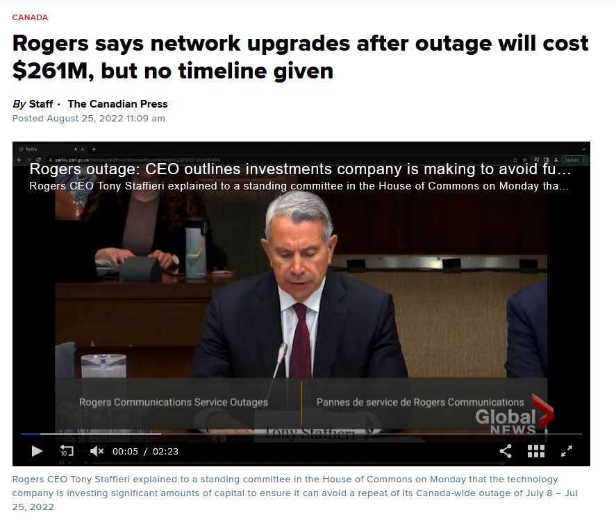
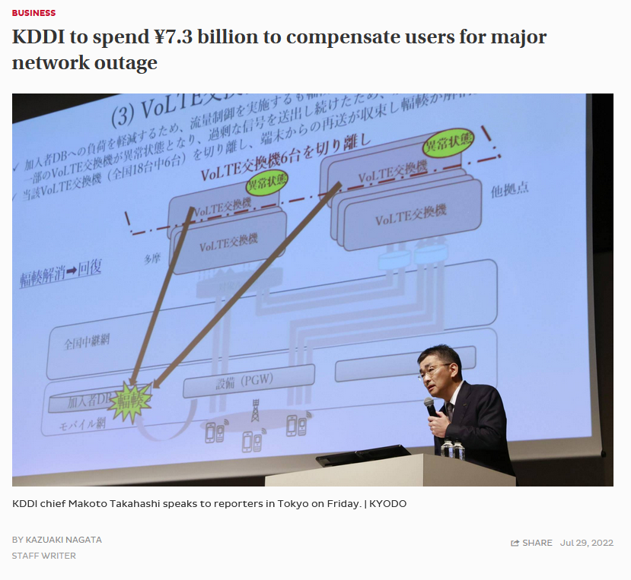

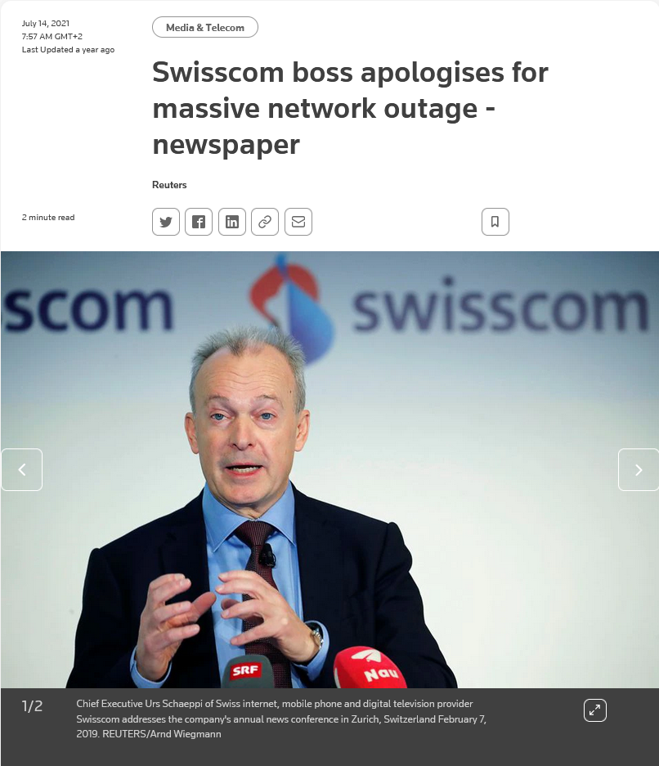
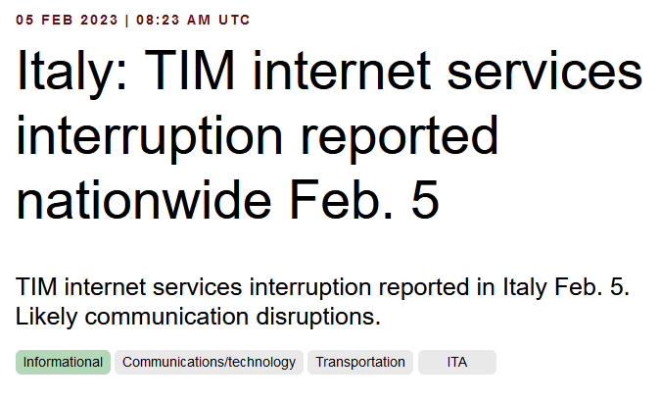
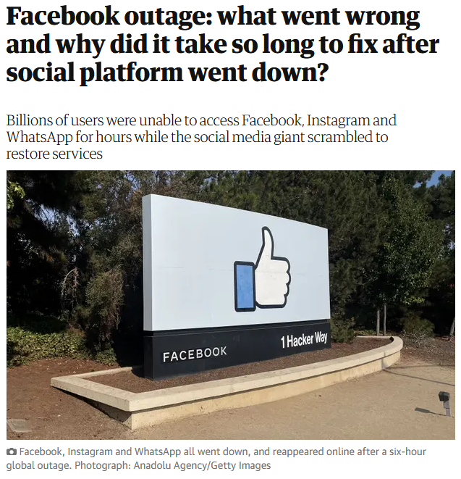
Nationwide Network Outages everywhere Increasing in impact and duration - hinting Network Visibility deficiencies

Slide 3

«
The customer knows before Swisscom that there is service interruption.
Unable to recognize impact and root cause when configurational or operational network changes occur.
Swisscom suffers reputation damage. We need to work together to mediate.
«
Markus Reber
Head of Networks at Swisscom

Slide 4
“ It is our duty to recognize service interruption before our customer does. Why do we still often fail to be first ? “

Slide 5

«
From Network Analytics Postmortems we understood that roughly 50% of the major network incidents are configuration related.
Network engineers unable to understand all the end-to-end dependencies on all the layers in highly virtualized networks.
«
Thomas Graf
Distinguished Network Engineer
and Network Analytics Architect at Swisscom

Slide 6

«
Within an 8 months Network Anomaly Detection Proof of Concept, we observed that reaction times to operational and configurational changes in the network was reduced, but also initial context helped to quicker identify the root cause.
To further improve, ietf-network.yang defined in RFC 8345 details network modelling, especially on configurational aspects.
«
Thomas Graf
Distinguished Network Engineer
and Network Analytics Architect at Swisscom

Slide 7

«
The Digital Map, draft-havel-opsawg-digital-map, points correctly out that missing Bidirectional links and support for Multi-point connectivity in RFC 8345 ietf-network.yang makes the implementation rather complicated or even renders certain topologies as unusable.
«

Slide 8

«
And finally, and most importantly, with the Digital Map network modelling, the foundation for simulating network configuration changes in lab is at reach. Preventing networking incidents from evening happening.
Resolving the problem that lab environments are never identical to production network.
«

Slide 9
“ Without network visibility, no informed decisions can be made. “

Slide 10
Monitor L3 VPN Relationships in Near Real-Time What Interfaces are for Flows, Peerings are for BGP
Interface State - Determine which Interfaces belong to the L3 VPN and track their state.
BGP Peering State - Determine which BGP peerings belong to the L3 VPN and track their state.
BGP Updates/Withdrawals - Determine which BGP paths belong to the L3 VPN and track their state.
Traffic Drop - Determine which traffic flows belong to the L3 VPN and track wherever the dropped byte count spikes.
Flow Count Change - Determine which traffic flows belong to the L3 VPN and track wherever the flow count drops or spikes.
Missing Traffic - Determine which traffic flows belong to the L3 VPN and compare the forwarded byte count to previous week.

Slide 11
From Network to Alert Event Observe multiple perspectives at different times
A single link down result in multiple device topology, control-plane and forwarding-plane events being exposed at different times.
Determine which interfaces and BGP peerings are being used first and then observe state. Observe BGP withdrawals and updates, traffic drop spikes and missing traffic. Generate multiple concerns.
Calculate for each check a concern score between 0 and 1. The higher, the more probable the changes impacted forwarding.
Unify several concerns for one VPN connectivity service to one alert identifier.

Slide 12
Network Anomaly Detection PoC Detail Multiple Perspectives increases Accuracy
Key Facts
Networks are deterministic, Customers somewhat holds true.
Max Concern score ranged between 0.25 and 0.85. In average 0.46.
Incident patterns are repetitive. Month by month scoring improvements visible.
Individual expert rule accuracy is beyond 90%. Summed accuracy is beyond 95%.
Record and Replay Digital Twin works like a charm.
In 4 cases additional YANG, in 2 cases additional BMP, in 2 cases Netconf Transaction-ID and 1 case additional L2 IPFIX metrics would have helped to gain more visibility.
Presented at ANRW 2023 at IETF 117 on Monday July 24th 15:30 – 17:00.
1
One out of Six checks
1
Four out of Six checks
10 Network Incidents
5
Three out of Six checks
3
Two out of Six checks

Slide 13
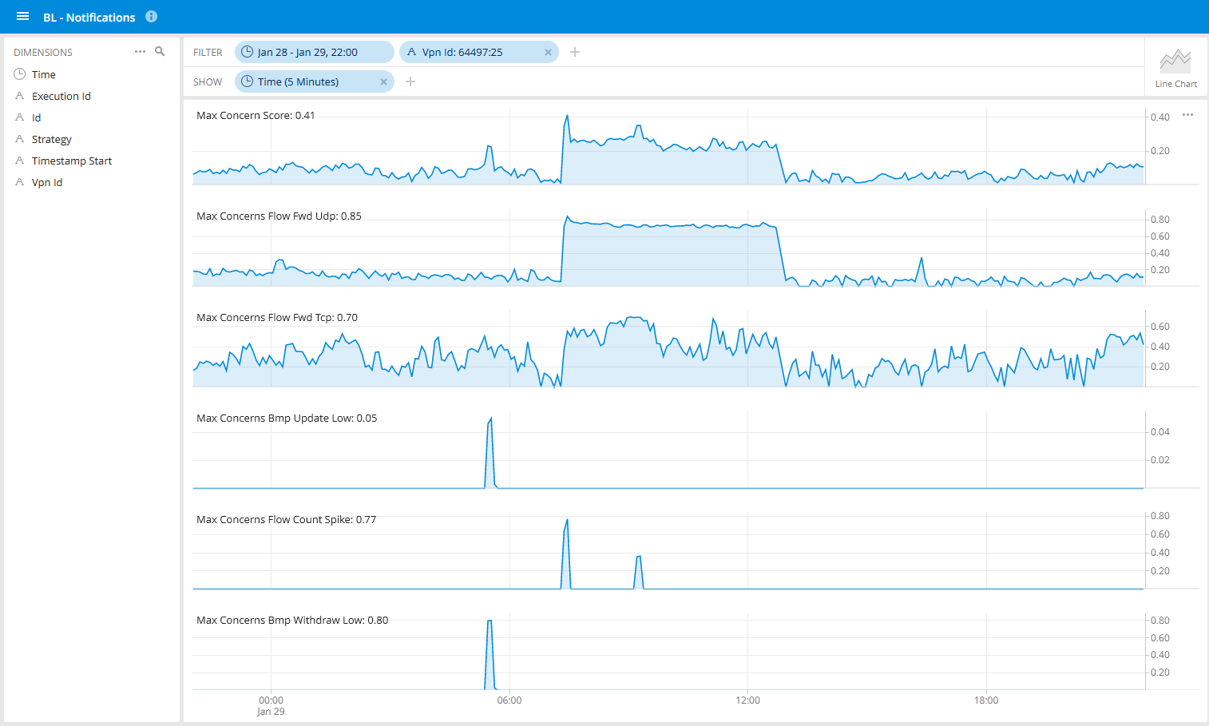
January 29th 2023, B2B Customer LAN-I Secure CER Traffic Blackholing Logical Connection 785 - L3 VPN monitored By Network Anomaly Detection

Slide 14

«
Imagine that with such a Network Anomaly Detection alert, a reference to the Digital Map is included, dependencies are being shown in real-time and you can play the changes backwards in time.
«

